Slide 1
ML PROJECT FIGURES

Slide 2
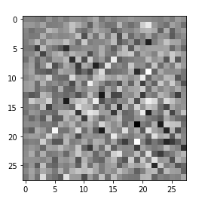


Generator
OUTPUT
IMAGE
$$Z$$
DENSE / RESHAPE LAYERS TRANSFORM
NOISE INTO 2D IMAGE
2D CONV / UPSAMPLE
Z – INPUT NOISE VECTOR

Slide 3
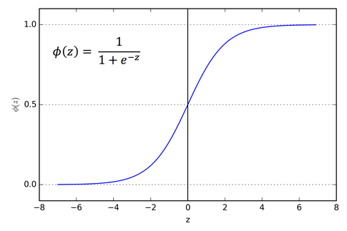
Discriminator
SIGMOID (Classifies Probability(REAL) [0,1])
FLATTEN
2D CONV / DOWNSAMPLING

Slide 4
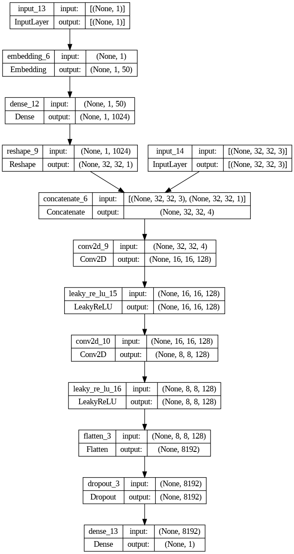
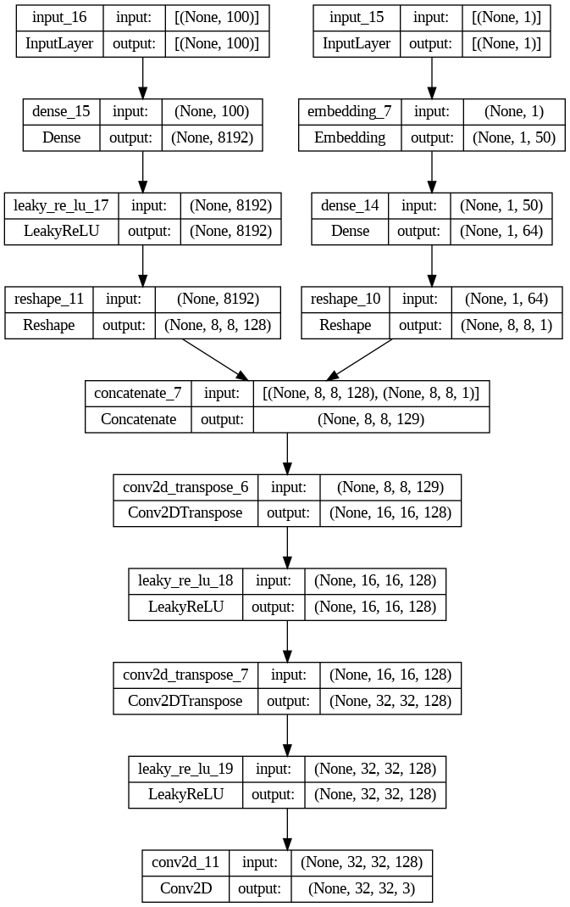







CGAN GENERATOR
CGAN
DISCRIMINATOR
$$X_{FAKE} \&{ X}_{REAL}$$
$$Z$$
$$Y$$
$$Y$$
$$IMAGES$$
$$IMAGES$$
$$X_{FAKE}$$

Slide 5
FID SCORES
 |  | MODELS
CIFAR10 |  | MODE COLLAPSE | TUNED 50 EPOCHS | TUNED 200 EPOCHS
CLASSES | AIRPLANE | 336.402 | 144.552 | 135.885
 | AUTOMOBILE | 346.599 | 164.511 | 145.301
 | BIRD | 295.096 | 154.471 | 141.674
 | CAT | 315.103 | 139.001 | 128.871
 | DEER | 272.295 | 117.34 | 112.269
 | DOG | 311.634 | 151.307 | 147.482
 | FROG | 257.361 | 117.945 | 105.914
 | HORSE | 334.465 | 160.527 | 144.395
 | SHIP | 317.615 | 141.108 | 136.754
 | TRUCK | 329.758 | 161.552 | 137.082

